Slide 1
CL & CV Project

Slide 2

START
Fri Apr 26th
Submit
MON Apr 29TH
Trainers start to evaluate
Edit your CL&CV
Submit to google classroom

Slide 3
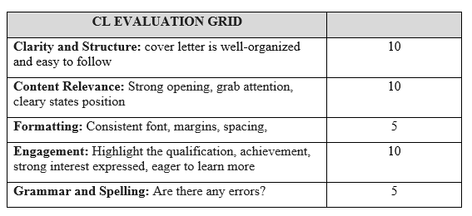
Grid for CL

Slide 4
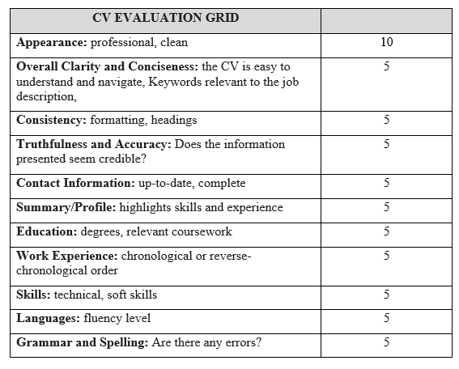
Grid for CV

